Slide 1
Explicit Control Over Spin-states in Technology and Biochemistry (ECOSTBio)

Slide 2
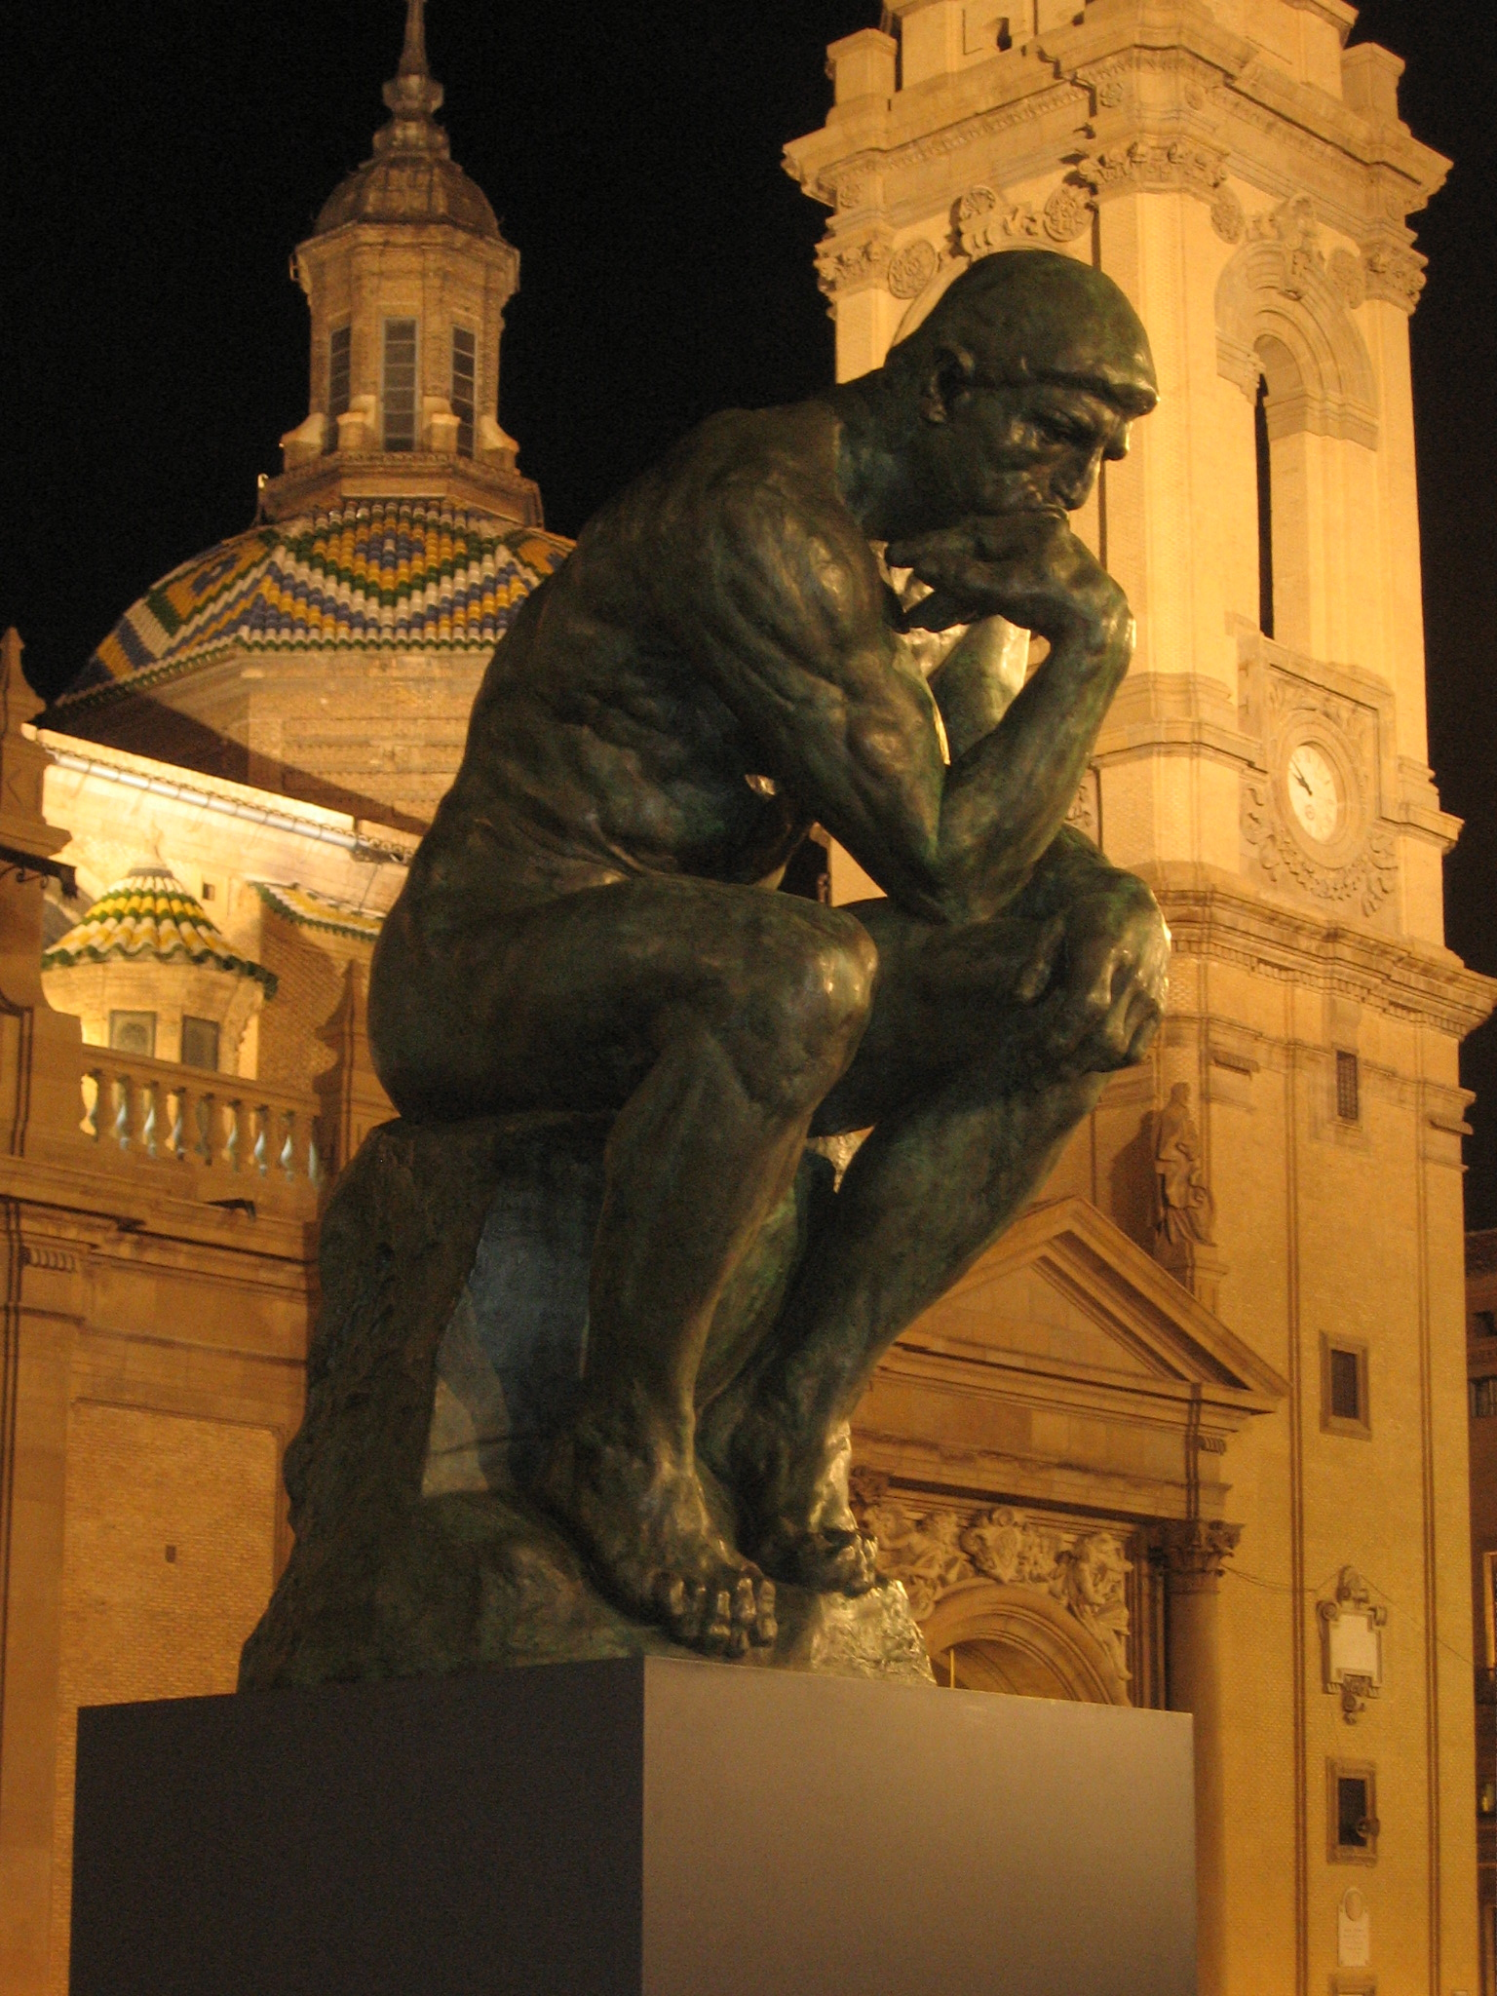
History of proposal
Follow-up of CECAM/ESF-Intelbiomat workshop in Zaragoza (Sept. 2012) on “Spin states in biochemistry and inorganic chemistry”
36 participants in Zaragoza
  both experimentalists and theoreticians
  experts and young scientists
Secured funding from CECAM, ESF-Intelbiomat and SCM
  21.400 €
Highlights:
  Nature Chem. 2013, 5, 7-9 (Costas, Harvey), “Discussion of an open problem”
  An. Quím. 2013, 109, 70
“The Thinker” – Rodin,
exhibition in Zaragoza:
"Auguste Rodin Art in the Street”,
picture: M. Swart, 2010

Slide 3
Background spin states
Quantum mechanics rears its head in many places and one of them is inorganic chemistry, where the electronic spin associated with unpaired electrons has a profound influence.
  “Molecules with different numbers of unpaired electrons, hence with different spin states, have distinct geometric structures, energetic properties and reactivity. Complexes of redox-active transition metal complexes can exist in many different spin states, and this plays an important role in inorganic chemistry and, because of the prevalence of transition metals in living systems, in bioinorganic chemistry.“
  “It is increasingly recognized that many reactions of biological and technological interest that are mediated by transition metal complexes can take place through multiple paths differing in the spin state. This has been termed multistate reactivity scenarios. Recognizing and understanding the impact of the spin in reactivity may be used to design molecules with enhanced reactivity properties.”
  Nature Chem. 2013, 5, 7-9 (Costas, Harvey), “Discussion of an open problem”

Slide 4
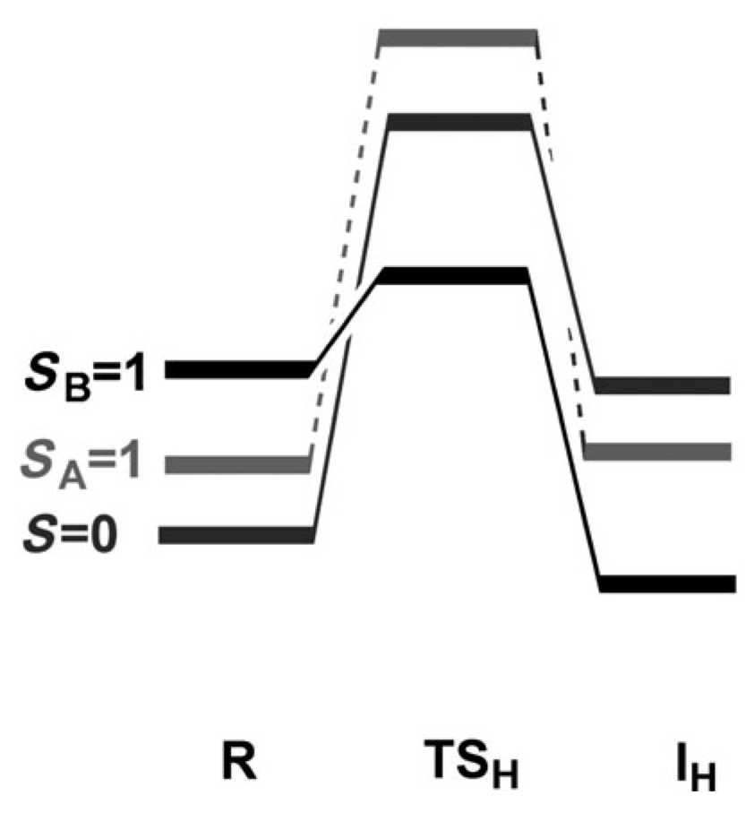
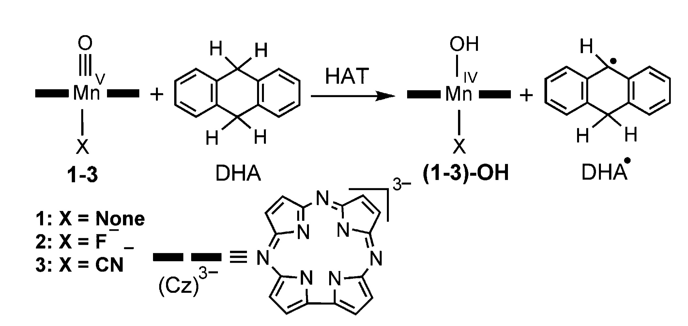
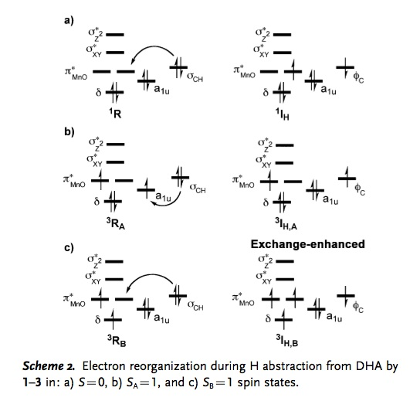
Changing spin state in catalysis
Exchange-enhanced reactivity concept by Sason Shaik, Nature Chem. 2011, 3, 19-27
(Shaik) Angew. Chem. Int. Ed. 2012, 51, 4421-4425

Slide 5
Changing spin states (contd.)
Cyt. P450 enzymes
  at least two spin flips in catalytic cycle!
  rebound mechanism
  compound I
    suspected in 2000, (Schlichting) Science 2000, 287, 1615
    proven in 2010, (Green)
    Science 2010, 330, 933
    spin state unclear
  theoretical perspective
    (Shaik) Chem. Rev. 2005, 105, 2279
  structure and reactivity
    (Shaik) Chem. Rev. 2010, 110, 949
Relevance for theory first noticed in 2001
  (Trautwein) Inorg. Chem. 2001, 40, 2201
  spin-crossover compounds
    depending on method either always low spin,
    or always high spin
    NO CROSSOVER
Rule of thumb
  early pure functionals: LS
  hybrid functionals: HS
  few functionals do well
    (Swart) JCTC 2008, 4, 2057; CPL 2013, 580, 166
  “Continuing Voyage Through the Density Functional Minefield”
    (Deeth), EurJIC (ASAP)

Slide 6
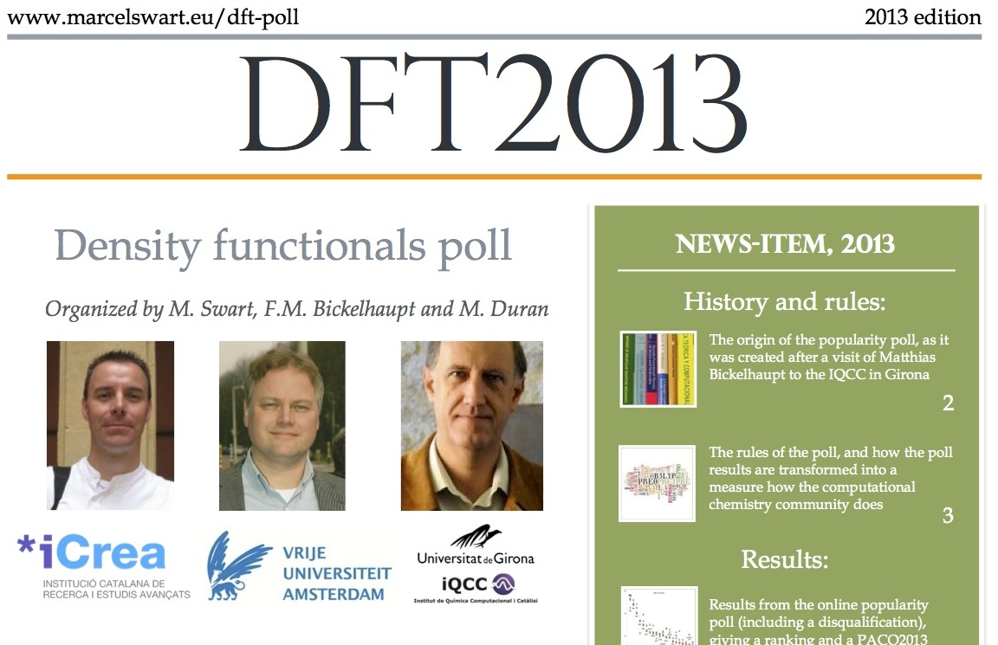
Online popularity poll
Polling preferences of computational chemistry community
  annually, between June 1 and October 1
http://www.marcelswart.eu/dft-poll (general)
http://goo.gl/7wfPMh (#DFT2014 poll, open until Oct. 1 !!!)
Newsitem 2014
  October this year
Blog Famous Chemistry
journal
  also existing 5 years

Slide 7
Theory is not alone
Experiment may be faulty as well
  disproportionation of two Fe^{III}-complexes to:
  Fe^{II} + Fe^{III} + solvent radical
    (Swart) Dalton Trans. 2011, 40, 8419
  impurity / contaminant
    (Münck) Science 2003, 299, 1037
  complementary vs. contradictory
    different experimental and computational techniques
Highlighted in
  (Swart) book chapter in "Quantum Biochemistry"; Matta, C.F. (Ed.); Wiley, 2010, Vol. 2,
  Ch. 19, p. 551-583
  (Swart) Int. J. Quant. Chem. (Perspective) 2013, 113, 2-7
  (Harvey) WIREs Comput. Mol. Sci. 2014, 4, 1-14
  Edited book on spin states (Wiley, 2015)
  Swart, Costas (Eds.)

Slide 8
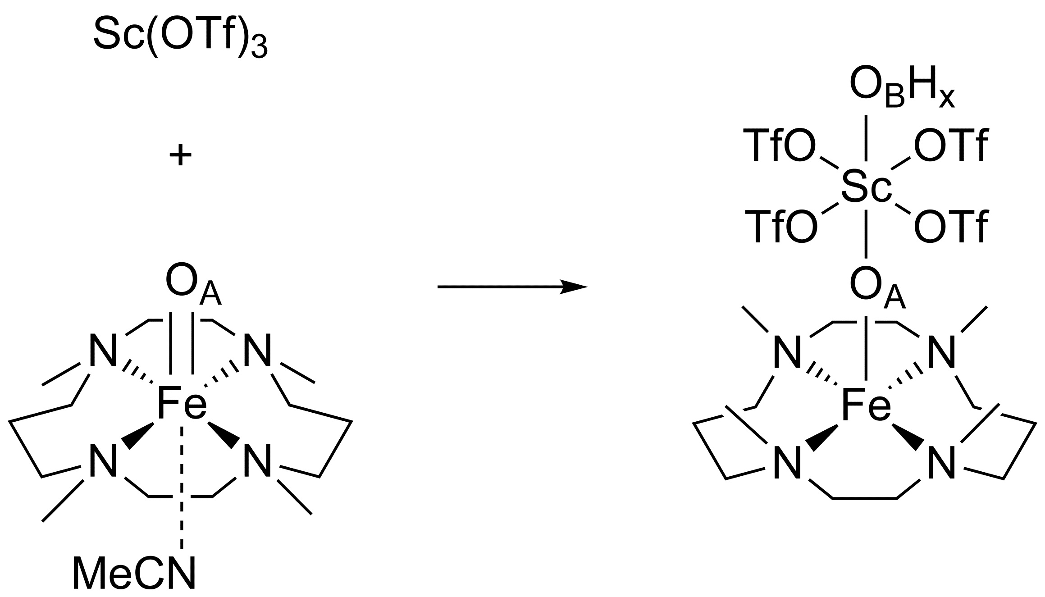
A Case Study: Distortion of Fe-O complex
Fukuzumi, Nam et al., Nature Chem. 2010, 2, 756
  Fe^{IV}-complex loses axial ligand, scandium picks up 4th triflate, and methyl groups flip!!!
Oxidation state doubted
  (McDonald, Que Jr.) Coord. Chem. Rev. 2013, 257, 414
  no Mössbauer possible
Calculations confirm Fe^{III}, and not claimed Fe^{IV}
  (Swart) Chem. Comm. 2013, 49, 6650
    validation computational setup on 16 Fe^{III}/Fe^{IV} complexes
    high spin state
    many computational methods fail

Slide 9
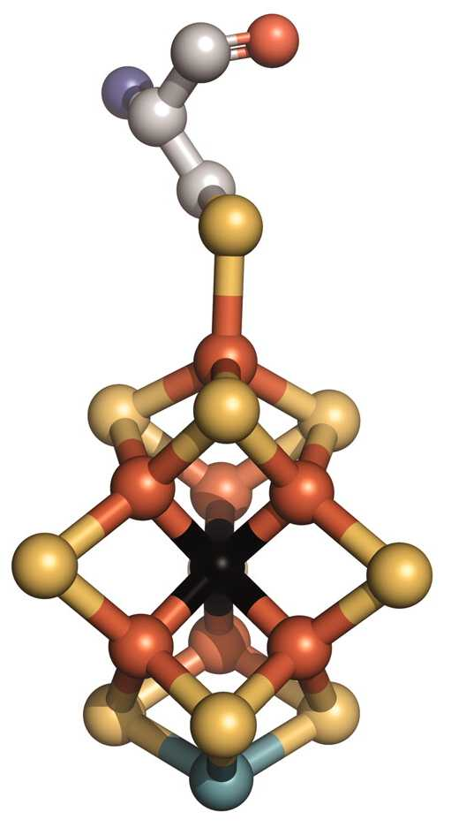
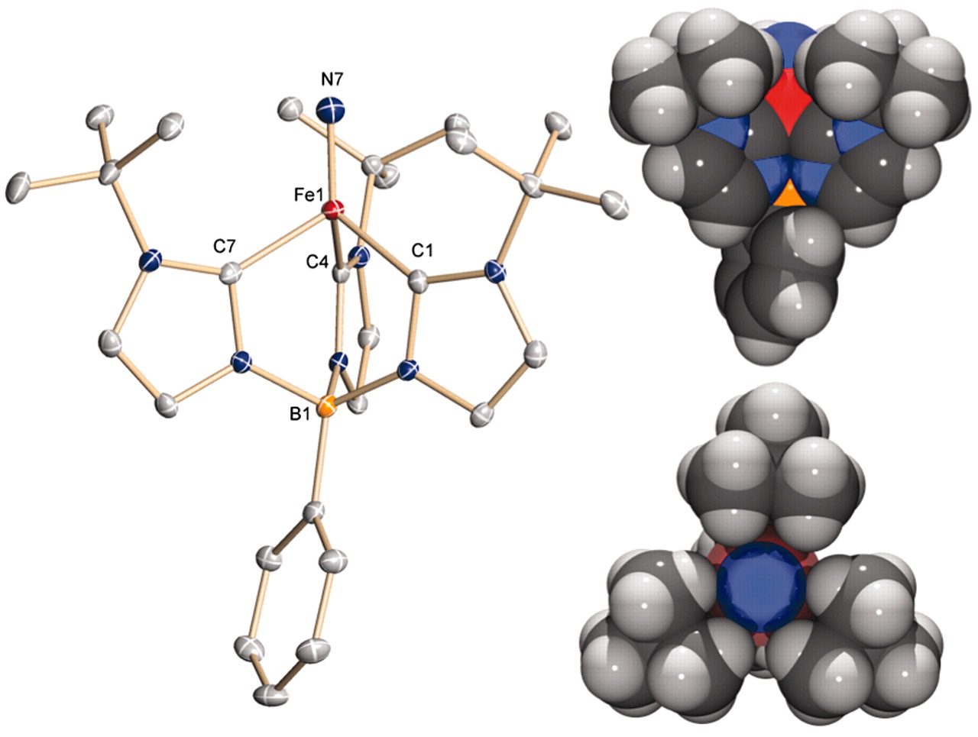
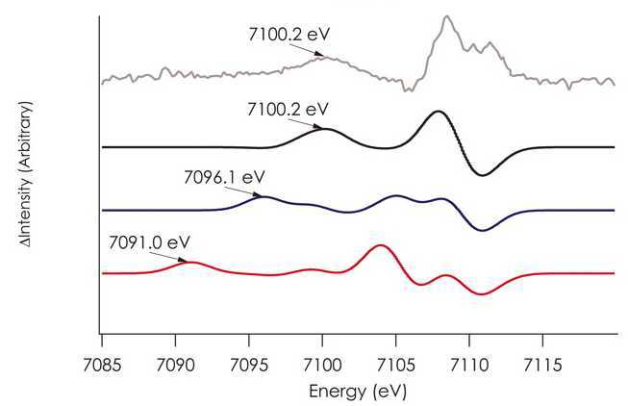
Together we’re strong
Synthesis, Structure, and Reactivity of an Iron(V) Nitride
  K. Meyer et al.
  Science 2011, 331, 1049
    d³ iron(V), low-spin
    X-ray, Mössbauer, EPR, Quantum Chemistry
Nature of “missing” atom in FeMo-cofactor
  Neese, DeBeer et al., Science 2011, 334, 974
    X-ray Emission, DFT

Slide 10
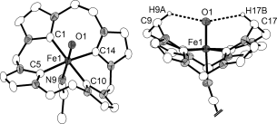
Together we’re strong (contd.)
A Tetracarbene-Oxoiron(IV) Complex
  F. Meyer et al., Angew. Chem. Int. Ed. 2013, 52, 901
  exceedingly high separation between S=1 ground-state and S=2 high-spin state; unusual spectroscopy
  organometallic chemistry inspired by biology
  X-ray, Mössbauer, DFT
Main recommendation of Zaragoza: combining results in database
  freely accessible
  should contain experimental and computational data
  complementary information
Second recommendation
  collaborations needed
  experiment needs theory, theory needs experiment

Slide 11
Networking within the ECOSTBio Action
SYNTHESIS
SPECTROSCOPY
THEORY
CATALYSIS

Slide 12
ECOSTBio Action
The aim of ECOSTBio is
to establish a European network of researchers dedicated to the understanding and application of spin-states in technological and biological applications
  creation of SPINSTATES database for long-lasting impact on bioinorganic chemistry, inorganic chemistry, biology and technology
Objectives
  database well-characterized transition-metal complexes, both experimental and computational data
  study of relevant complexes through a joint experimental/theoretical effort for spin state properties
  design new computational methods
  explicit control of spin states through rational design of ligand coordination
    based on theory, proven by experiment

Slide 13
ECOSTBio Action (contd.)
“Secondary” objectives
  encourage multidisciplinary activities within ECOSTBio and with neighbouring disciplines
  sharing of know-how and facilitating training possibilities to Early Stage Researchers
  increase the level of understanding of scientific issues of the Action
  dissemination of the Action’s results and raising awareness

Slide 14
Working Groups
Spin crossover
Enzymatic spin states
SPINSTATES Database
Biomimetic spin states

Slide 15
SPINSTATES database
Characterization
  Computational Chemistry
  EPR Spectroscopy
  UV-Vis Spectroscopy
  X-ray Absorption / Emission Spectroscopy
  EXAFS
  NMR
  Resonance Raman
  Mössbauer
Backwards compatibility
  previous studies by experts
  literature data
Data consistently and uniformly available
  general data (molecular formula, total charge)
  physical data (solvent, counter-ion, etc.)
  spin state (how determined)
  spectroscopic properties
  computational data
  technical details
  comments
  additional information
Online, freely accessible
  scientific community at large

Slide 16
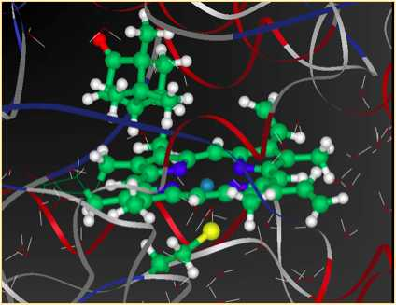
Enzymatic spin states
Often metal cofactors
  metal-oxo species
    compound I, P450s
  FeMo-cofactor
    nitrogen fixation
      complex cycle, >12 steps
    Neese, DeBeer et al., Science 2011, 334, 974
    oxidation state and spin state unknown!!
      Mo^{III} ?!?!?
      Chem. Sci. 2014, 5, 3096
Effect of spin state on reaction steps
Identity of ground states
  metal centre
  first-sphere residues
  ancillary ligands (water, amino acid side-chains)
  structural (entatic state)
  electrostatic (protein environment)

Slide 17
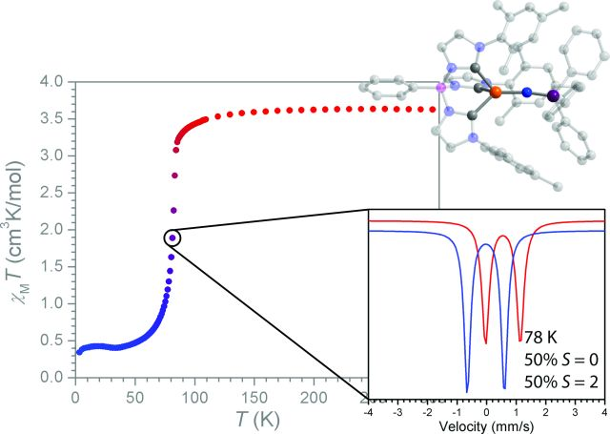
Spin crossover
Switching between states
  induced by external factors
    temperature
    pressure
    light (LIESST)
  gradual or abrupt
  hysteresis
  single-step or multi-step
Discovery SCO materials rooted in serendipity
  required HS-LS energy balance is subtle
  experimentally challenging
  cooperativity important
  understand detailed nature of cooperativity
  explore novel ligand-metal combinations for new SCO species
    based on molecular modelling, proven by experiments

Slide 18
Biomimetic spin states
Catalytic mechanisms not well understood, especially regarding spin states
  metal-oxo or metal-imido
  enzymes: often high-spin
  biomimetic models: intermediate spin
Reactivity of e.g. triplet and quintet states (Fe^{IV}) similar
  exchange-enhanced reactivity at work?
Rational design of spin state: ligand coordination
  weak-field ligands or lower coordination: high spin
  strong-field ligands, higher coordination: low spin
  so far, mainly high-valent Fe
    Mn, Co, Ni, Cu
  efforts towards S=0 Fe-oxo
    UV-Vis, EPR, NMR, rRaman, Mössbauer, EXAFS, DFT/post-HF
  correlation of spin state with reactivity

Slide 19
Timetable
Year 1:
  Management Committee Meeting, Kick-Off Meeting, Establishment of SPINSTATE database, Short-Term Scientific Missions
Year 2:
  Working Group Meetings, Short-Term Scientific Missions, MC Meeting, Halfway Assessment, International Meeting, Workshop Young Researchers
Year 3:
  Working Group Meetings, Short-Term Scientific Missions, MC Meeting, Workshop Young Researchers
Year 4:
  Working Group Meetings, Short-Term Scientific Missions, Closing MC Meeting, International Meeting, Workshop Young Researchers, Final Report

Slide 20
Deliverables and Milestones
Deliverables
  creation of online and freely accessible SPINSTATES database
  definition of suitable computational methods for proper description of spin-state properties of transition-metal complexes
  training facilities and formation of young researchers
Organizational Milestones
  formation of Working Groups
  starting STSMs
  website implementation
  establishment database
  annual memoirs
  organization of international meetings dedicated to spin states in (bio)chemistry and technology
  reviews and assessment of the Action

Slide 21























Participants
Participants: >84
  WG1: 84
  WG2: 19 (34)
  WG3: 37 (51)
  WG4: 28 (50)
Female experts: 20
  9 experimentalists
  11 theoreticians
Evenly balanced
  ca. 40 experimentalists
  ca. 40 theoreticians
Countries: 23

Slide 22
Dissemination
Who?
  primary: research scientists
  secondary: general public
  tertiary: politicians, funding bodies
How?
  mainly through ECOSTBio website, central hub in dissemination
  workshops, meetings
  theses circulated within Action
What?
  scientific papers
  ECOSTBio website
    www.ecostbio.eu
  PhD/MSc theses
  press releases/highlights
  workshops/symposia
  patents
  social media
    Twitter, Facebook, Youtube, Wikipedia, etc.

Slide 23
Numbers of ECOSTBio Action (Sept. 2013)
Participating experts: 47
  Female Experts: 12
  Evenly balanced exp./theor.
Countries: 16
Economic dimension:
64M €
Four Working Groups:
  SPINSTATE database
  Enzymatic spin states
  Spin crossover
  Biomimetic spin states
Publications of Experts
  period 2008-2013
  Nature 2
  Science 4
  Nature Chem. 10
  Angew. Chem. 112
  J. Am. Chem. Soc. 142
  Chem. Comm. 59
  Chem. Sci. 17
  Chem. Eur. J. 117
  Chem. Rev. 3
  Chem. Soc. Rev. 10
  Coord. Chem. Rev. 24

Slide 25
ECOSTBio: Networking and output
Short-Term Scientific Missions
  please apply
    www.ecostbio.eu/stsm
  € 14.000 (Jun14-May15)
    € 3.850 allocated
    (3 approved STSMs so far)
Publications
  acknowledge ECOSTBio!!!
    Five papers mentioning ECOSTBio so far
  send your DOIs
    groups from two countries!
Meetings
  Jan. 12/13, Marseille
    WG + MC
  next 2-3 months, Girona
    small meeting database
  Proposals:
    summer 2015, Belgrade
    summer 2016, Prague
    ??, Budapest
    come to me with proposals
Website
  will be further updated

Slide 26
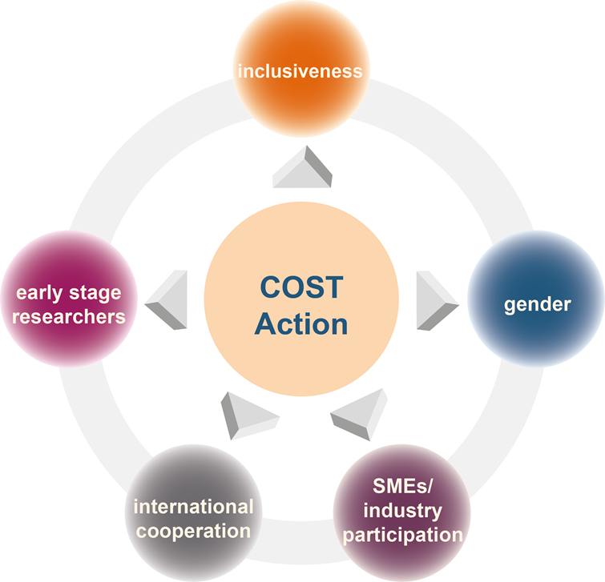
Policies COST and ECOSTBio
COST has identified its priorities and has developed policies on:
  Inclusiveness
    H2020
  Early stage researchers (ESR)
    <8 years after PhD defense
  Gender balance
  International cooperation
  SME / industry participation
  Exper./Theor. balance
  (ECOSTBio policy)

Slide 27
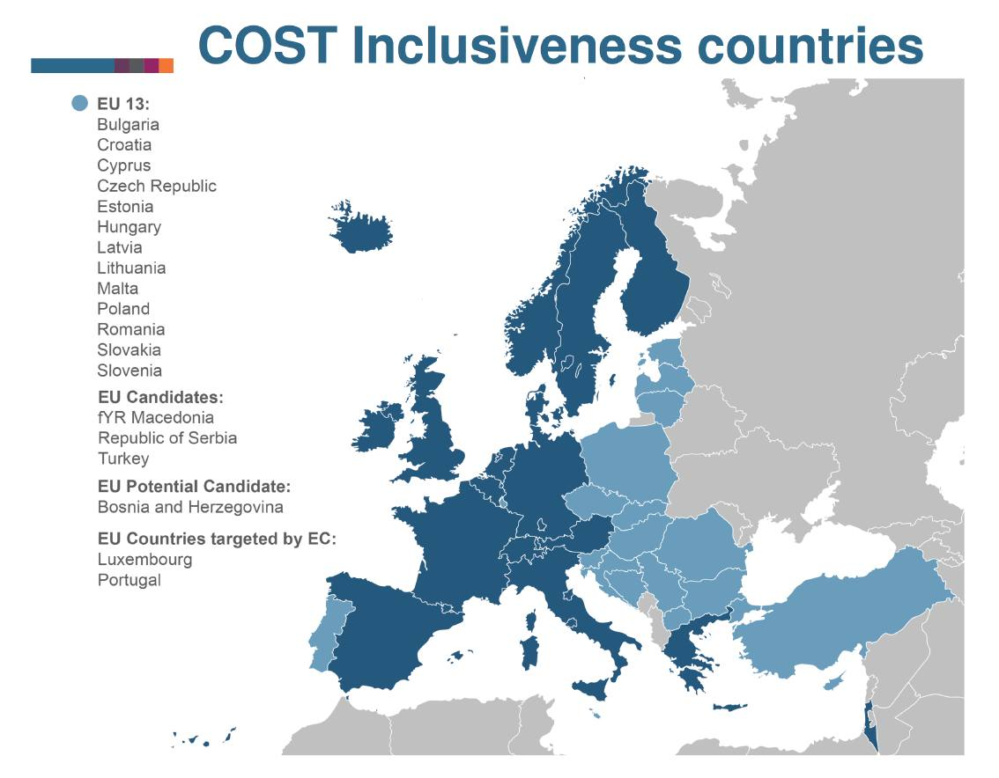
Inclusiveness Countries
Budget:
  50 % ‘Societal Challenges’
  50 % ‘Spreading Excellence and Widening Participation’
  Czech Republic
  Hungary
  Poland
  Romania
  Slovakia
  Slovenia
  Republic of Serbia
  Portugal
MISSING
  Bulgaria (*)
  Croatia (*)
  Cyprus (*)
  Estonia
  Latvia
  Lithuania
  Malta
  fYR Macedonia
  Turkey
  Bosnia & Herzegovina
  Luxembourg

Slide 28
Practical details (Girona meeting)
Monday
  coffee breaks, patio outside
    11.15h, 16.00h
  conference room locked
  lunch, Parc Migdia
    13.30h
  11.15h, PHOTO (outside)
  end of day: pica pica
    ca. 18.00h
  conference dinner
    Casa Marieta, 20.30h
  lunch fee
    e-cost, mea culpa
    will be corrected after
Tuesday
  9.00h bus to Ciències
  9.30h-10.15h WG1
  10.15h-13.30h separate sessions WGs
  coffee breaks, lunch
    Ciències
  14.30h-17.30h, MC meeting
  19.00h-20.30h
  Guided tour old city Girona
  (leaving from hotel)

Slide 29
Practical details e-COST reimbursement
Scan or PDF of travel documents
  if local travel < €25 (total) no documents needed
Exact amount to be put
Taxi: only in exceptional circumstances (e.g. arriving after 23.00h, or leaving before 07.00h)
Car kms: Mappy printout to be added
Hotel: Flat Rate
Meals: Flat Rate
  Both are automatically entered when you put the time you left home, and when you returned home
  Provided meals will not be elegible
Original invoices/receipts must be kept by the claimant, until 2 years after the end of H2020 for audit purposes:
30 April 2023

Slide 30
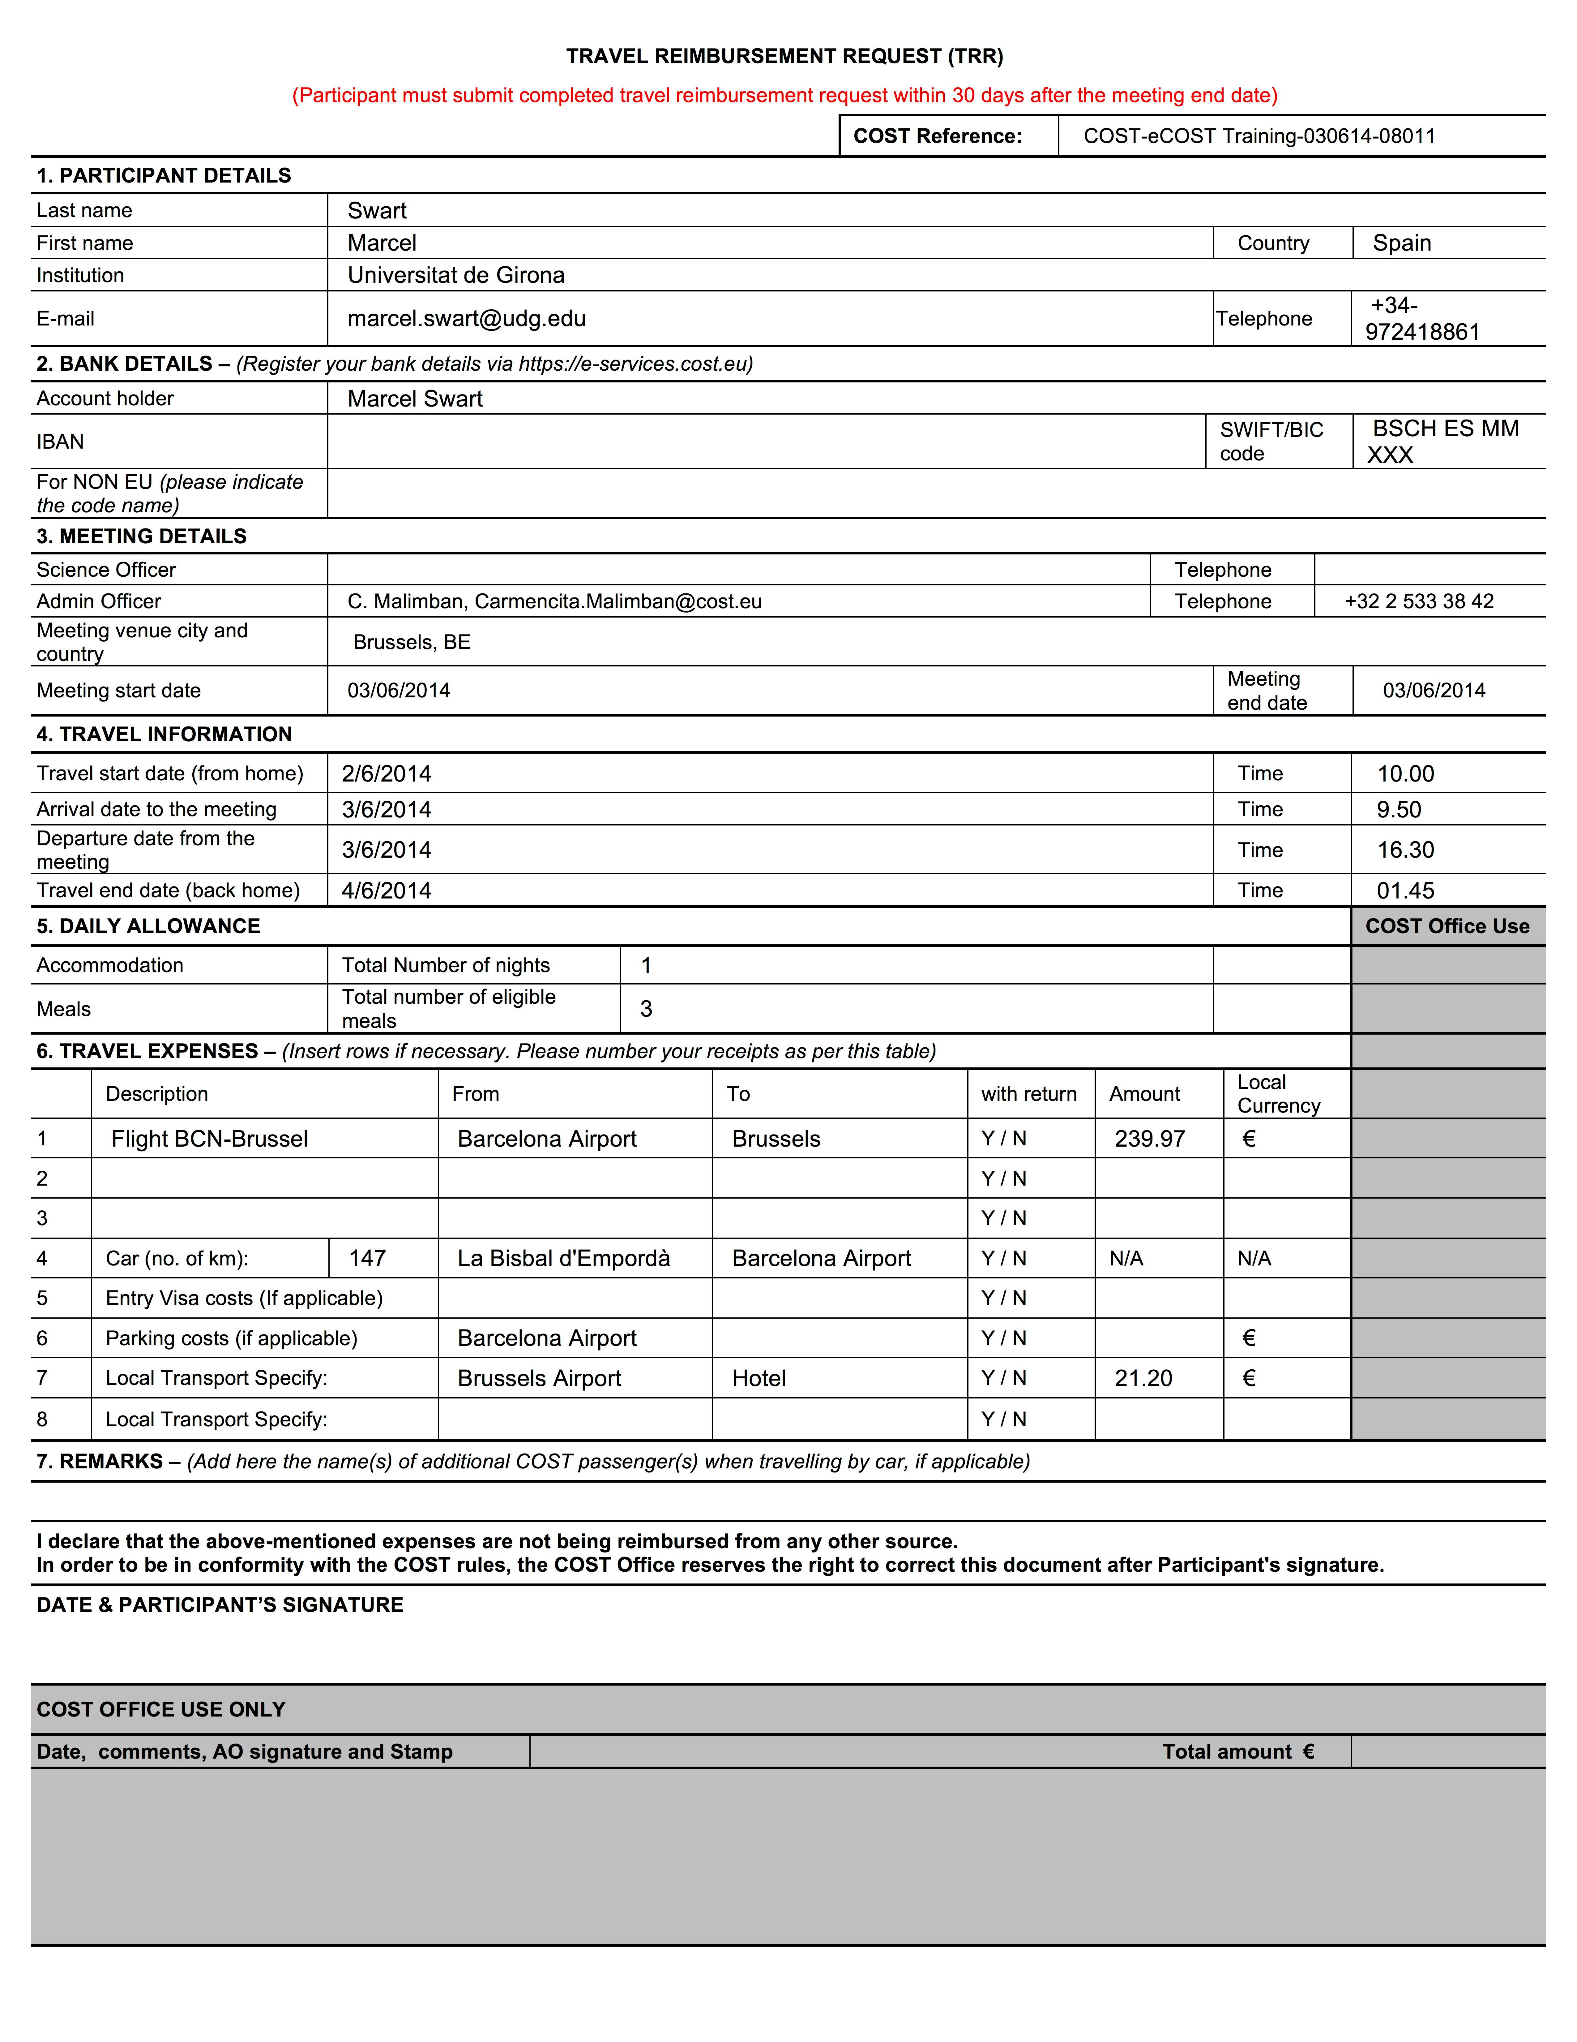
Travel Reimbursement Request (TRR) form
After having put every cost item into e-COST, at the end you will obtain a TRR form.
This you will have to
print, sign and send!
Maybe in the future
this last step of send
will be done
electronically
as well.
  Grant Holder decision

Slide 31
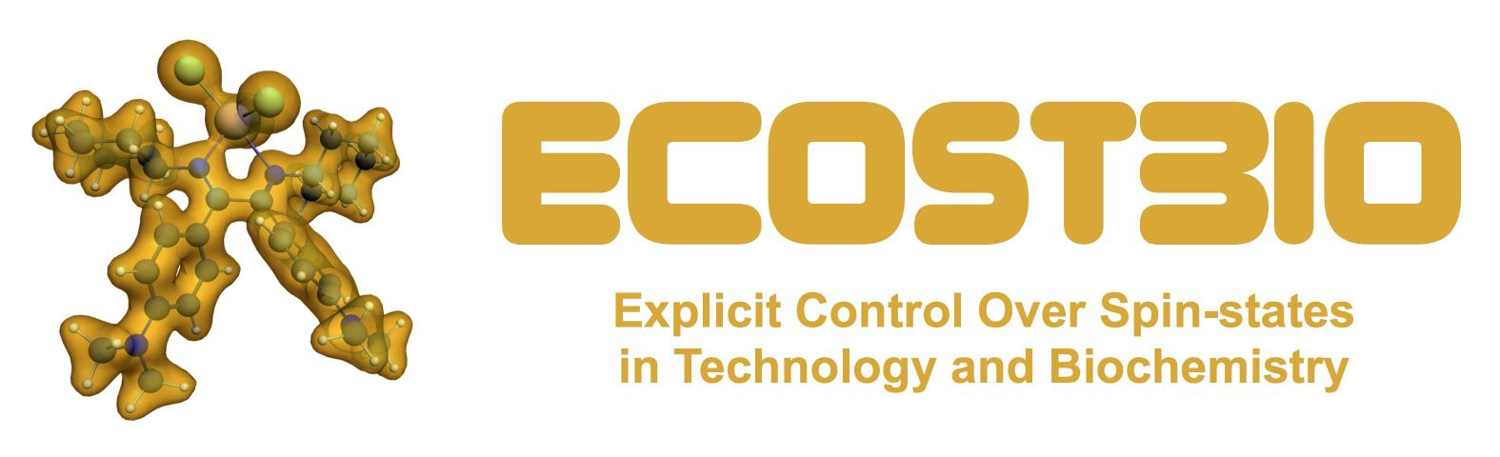
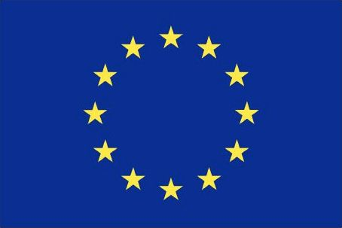

ECOSTBio, COST and H2020
Acknowledge ECOSTBio, COST and H2020
  papers, talks, posters, interviews, website, etc.
  logos:
    http://www.cost.eu/media/visualidentity
    http://www.ecostbio.eu/members/logos
Send me (ecostbio@gmail.com) papers, details of presentations, posters, interviews, etc. where ECOSTBio results have been shown

Slide 32
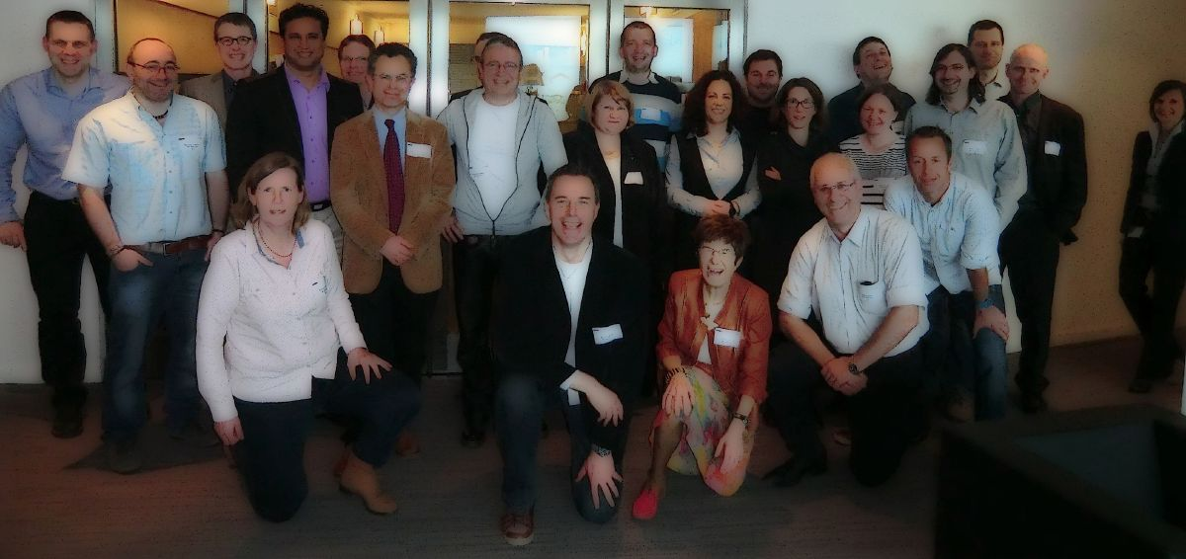
Enjoy, spread the news and collaborate….
Short-Term Scientific Missions!!!!

