Slide 1
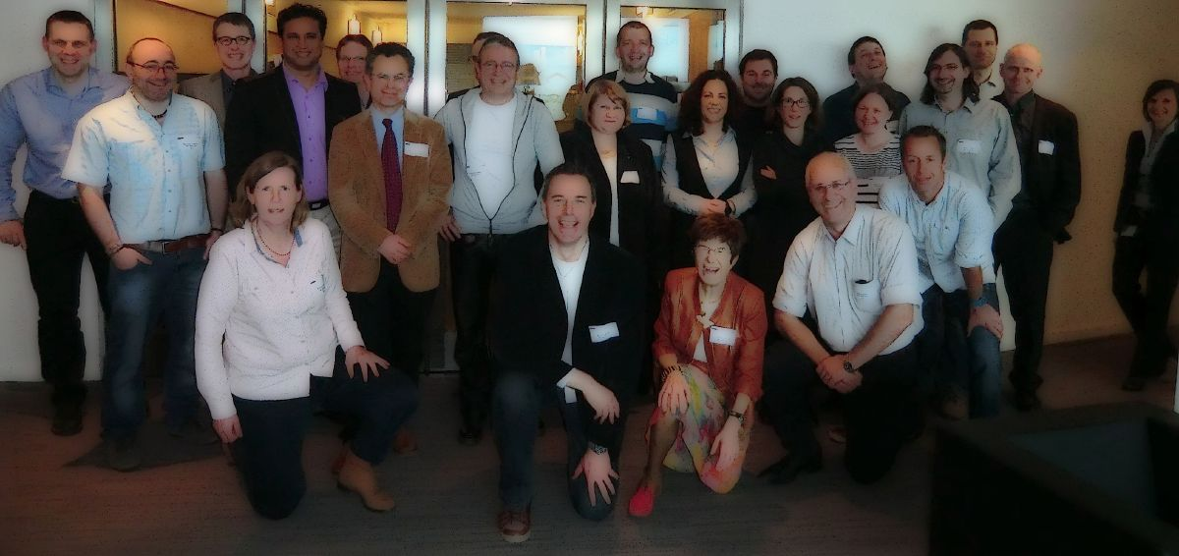
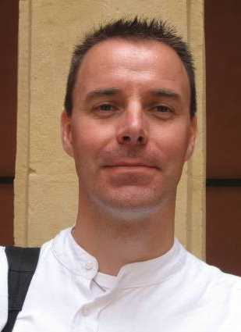



Groupname, City
marcel.swart@icrea.cat, @Marcel_Swart, http://www.marcelswart.eu
Notes:
• Please put here the name of your group/institute
• Please put here a picture with your group members
• Please put here a picture of the Principal Investigator involved in ECOSTBio
• Please put here any logos of your institute, funding agencies, etc.
• Please put e-mail address, (Twitter account, if any), website address

Slide 2
Groupname, City
Current group members
  4 Master students
  3 PhD
  2 postdocs
  1 staff (PI)
Theses supervised (2009-2014)
  3 undergraduate/Master students
  3 PhD students
Participation in COST Actions: 1
Institute
  14 research groups
  14 Full Professors
  28 postdocs
  28 PhD students
  56 Master students
  112 undergraduate students
Publications of group/PI
  66 (group, 2009-2014)
  345 (PI, all years)
Notes:
• Please give here an overview of the current size of the group
• Please give here a summary of the number of theses from the group in the last five years
• Please give the number of COST Actions the PI has participated in
• Please give here a rough summary of the research institute/department sizes (number of groups, number of professors, etc. etc.)
• Please give here the number of publications in the last five years (2009-2014) for the group
• Please give here the total number of publications of the PI

Slide 3
Research interests and expertise
Interests
  biocatalysis of high-valent Mn
  spin-crossover of Fe^{II}
  reaction mechanisms
  catalytic cycle P450 enzymes
  heme group
  parameterization MM
  (parallel) programming
Expertise
  DFT
  X-ray
  EPR
  Transition State localization
  Minimum Energy Crossing Point
  variable temperature Raman/UV-Vis
Metals (oxidation states)
  Fe^{II}, Fe^{III}, Fe^{IV}
  Mn^{II}, Mn^{IV}
  Co^{I}, Co^{IV}
Notes:
• Please add here the research interests of the group/institute
• Please add here the Expertise of the group members, especially those involved in ECOSTBio
• Please add here the transition metals on which you have worked

Slide 4
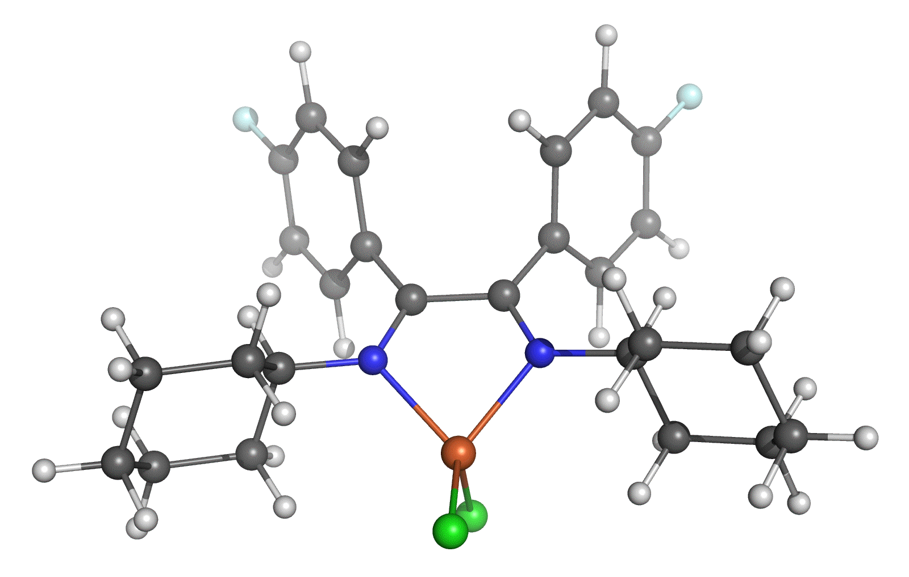
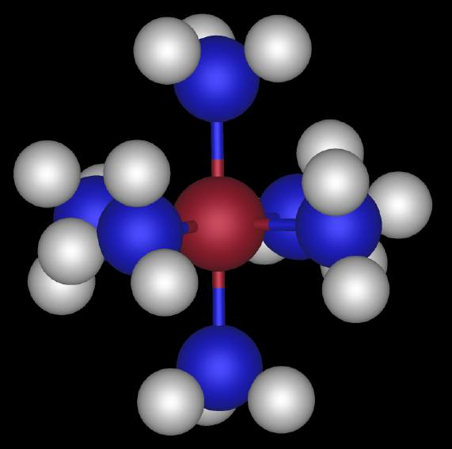
Recent studies
First structure of Fe^{VIII} complex
  Science 2014, 229, 0945-1800
Unusual spin-crossover
  Angew. Chem. Int. Ed. 2014, X, Y-Z
Notes:
• Please highlight some recent studies with pictures etc.

Slide 5
Resources
Computational
  clusters
  access to supercomputing facilities
Software
  available
  developed in-house
Parallel environment
  MPI, Open-MPI, Intel-MPI
Experimental
  lab space (xx m²)
  SQUID
  NMR (xx MHz)
  UV-Vis
  EPR (X-band, Q-band)
  Raman Microscopy
  ns time-resolved spectroscopy
  He/N₂ cooled 57-Mössbauer
Notes:
• Please describe here the equipment you have in-house, and the equipment you have access to
• Please add anything in as much detail as you think is interesting for future collaborations
• Please add pictures of your equipment if you have them
• Please add a picture of your lab if you have them
• Please add anything else which might be of use for future collaborations

Slide 6
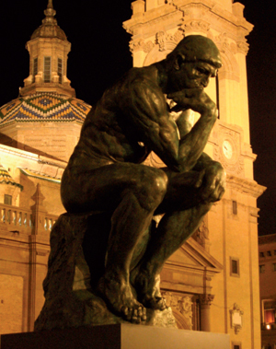
Free-format: Anything else
Anything else you want to add?
Free space for Short-Term Scientific Missions advertisements
Free space for posing availability to hold future meetings/summer schools, etc.
Notes:
• Here you have space to put whatever you want, and which you think is relevant for ECOSTBio
• For instance, if you want to host a meeting in the future, show us why we should choose your institute
• BUT KEEP IT WITHIN THE TIME LIMIT!!!

